Slide 1
Development of Mini Application of Indonesian Abusive Words Filter on Twitter with Descriptive Methods.
Written by: Febrian Nur Alam
DSC WAVE-7

Slide 2
01
02
The methodology
03
Intoduction
Dataset and Feature
04
05
06
Conclusion
Bibliography
Analyze
Road Map

Slide 3
INTRODUCTION
The development of technology that is increasingly advanced today makes it easier for humans to carry out various daily activities. Currently, the fastest growing technology is information and communication technology. One of them is the growth of online social media such as Twitter which is used to share facts or opinions of its users There will be negative comments that are a problem because they usually contain elements of hate speech and can lead to legal sanctions for the person doing the threatening.
The government in preventing and overcoming problems related to hate speech has issued legislation in the form of the ITE Law. Article 28 paragraph 2 of the ITE Law states that citizens are prohibited from disseminating information to cause hatred.
START
VALUE
GOAL
Part of machine learning, text analysis, has algorithms that can identify or classify text objects. This text analysis can be used to fight hate speech on social media as it can detect cyberbullying, offensive language, and cyber hate.
This research will create a system that can be used to classify hate speech, "Alay" words and identify non-standard language in a Tweet, then convert it into a standard language.

Slide 4
The methodology
1.
Data Classification
4.
The Min-app Development Process
The data is grouped into several categories, HS and Abusive are grouped into Toxic data, then based on the HS category it is grouped into HS_Individual, HS_Group, HS_Religion, HS_Race, HS_Physical, HS_Gender and HS_Other and finally Hate Speech data is grouped based on the level of existing HateSpeech. The data is grouped into HS_Weak, HS_Moderate and HS_Strong.
After going through the Preprocessing Stages and data modeling, the mini-application was developed. To make it easier for people to access this feature
2.
3.
Preprocessing Stages
Research Methods
The first step before a text data is processed further is to preprocess the text, the goal is to explore, process and organize the data. In text classification, text is grouped into several groups. The preprocessing stage is carried out to prepare the data so that the text data can be more structured by removing the noise in the data so that it is easier to process the data.
Descriptive method is a research method that aims to describe the characteristics of a phenomenon or population by collecting and analyzing existing data.

Slide 5
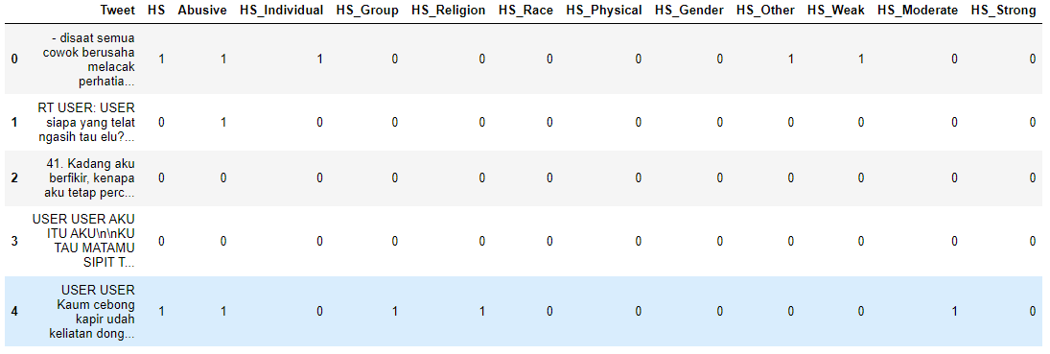
DATASET AND FEATURE
This dataset was obtained from Kaggle with the title "Indonesian Abusive and Hate Speech Twitter Text". In this data set, there is a collection of Tweets that have been grouped based on several categories including. Hate speech data abbreviated as HS, Abusive, HS_Individual, HS_Group, HS_Religion, HS_Race, HS_Physical, HS_Gender, HS_Other, HS_Weak, HS_Moderate and HS_Strong. This data has a total of 13169 tweets.

Slide 6
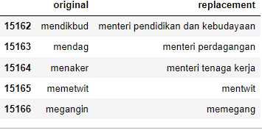
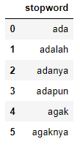
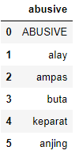
DATASET AND FEATURE
“Alay” Dictionary
Table Alay has 2 rows and has 15167 columns. This table contains "Alay" words and standard words.
Data Stopword
Data Abusive
Table Alay has 1 rows and has 772 columns. This data contains stopwords that are used to reduce useless characters.
Table Alay has 1 rows and has 132 columns. This data is used to remove abusive words in the main data.

Slide 7
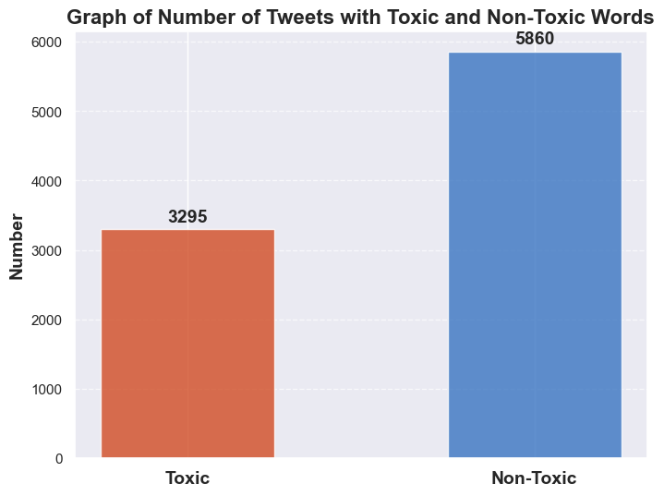
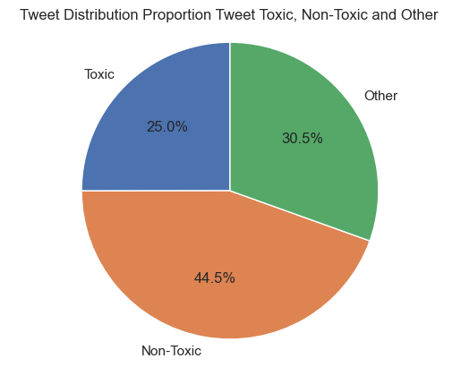
Result On 13.169 Data That Have Been Analyzed
If the tweet contains hatespeech data and abusive data then the tweet is categorized as a toxic tweet. In the main data, I analyze how many tweets are toxic, non-toxic. Here are the results:
Based on the results of tweet sentiment analysis, shows that Non-Toxic tweets are the most tweets which are around 5,860 (44.5%) tweets, followed by other tweets which are tweets containing hate speech or abusive as many as 4,014 (30.5%) tweets and the least is toxic tweets 3,295 (25%) tweets from a total of 13,169 tweets.

Slide 8
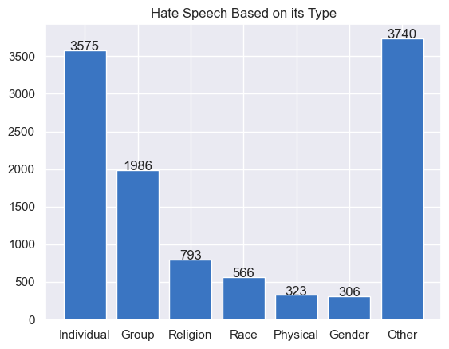
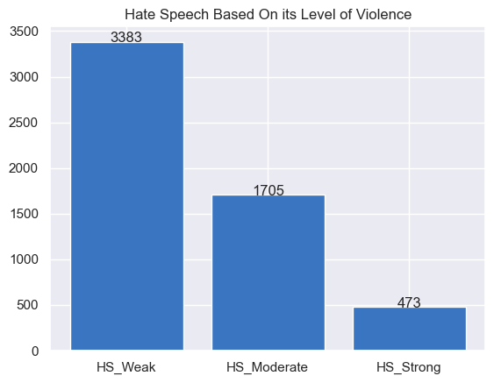
Result On 13.169 Data That Have Been Analyzed
Based on its type, hate speech is divided into 7 types, namely individual hate speech (3575), group hate speech (1986), religious hate speech (793), racial hate speech (566), physical hate speech (323), gender hate speech (306), and other hate speech (3740).
Based on the level of violence, hate speech is divided into 3 types, namely weak hate speech (3383), Moderate hate speech (1705), and strong hate speech (473)

Slide 9
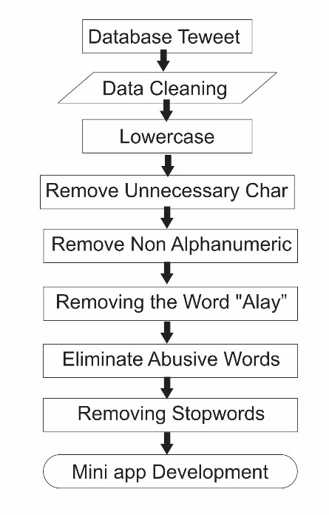
With the amount of hate speech in this data, it is necessary to develop a mini-application that can be used to process harsh words into standardized words. The following are the stages in the process of building a mini application to filter tweets containing hatespeech into standard tweets

Slide 10
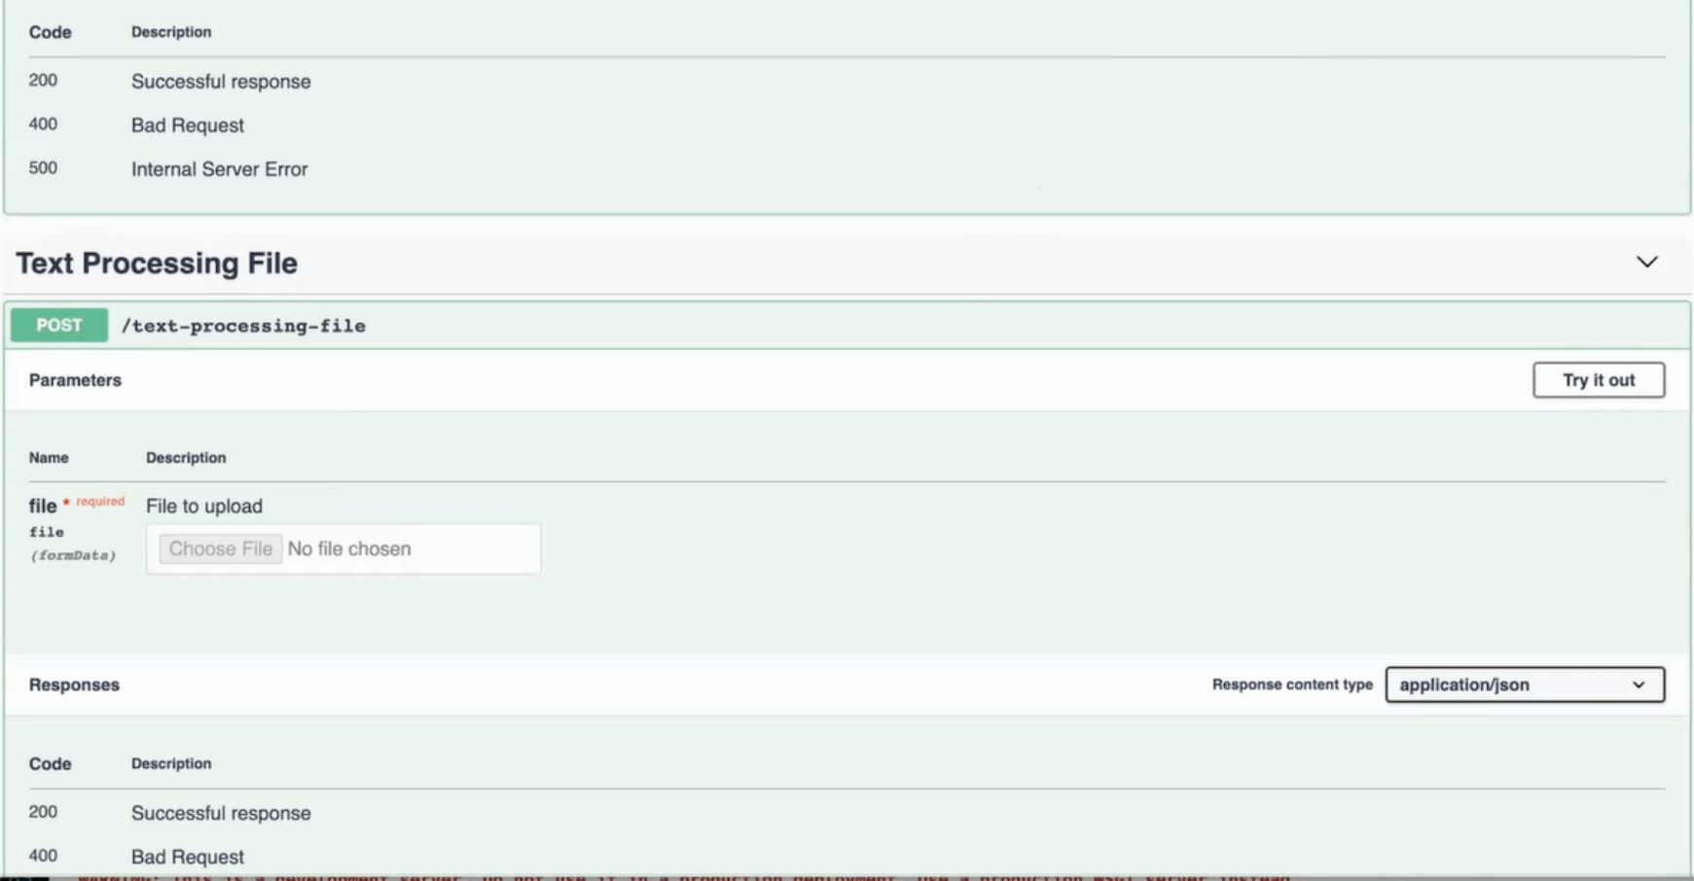
Mini-Application Development
The Mini-Application was developed to make the tweet cleaning process easier. The following is a view of the mini-application developed using swagger

Slide 11
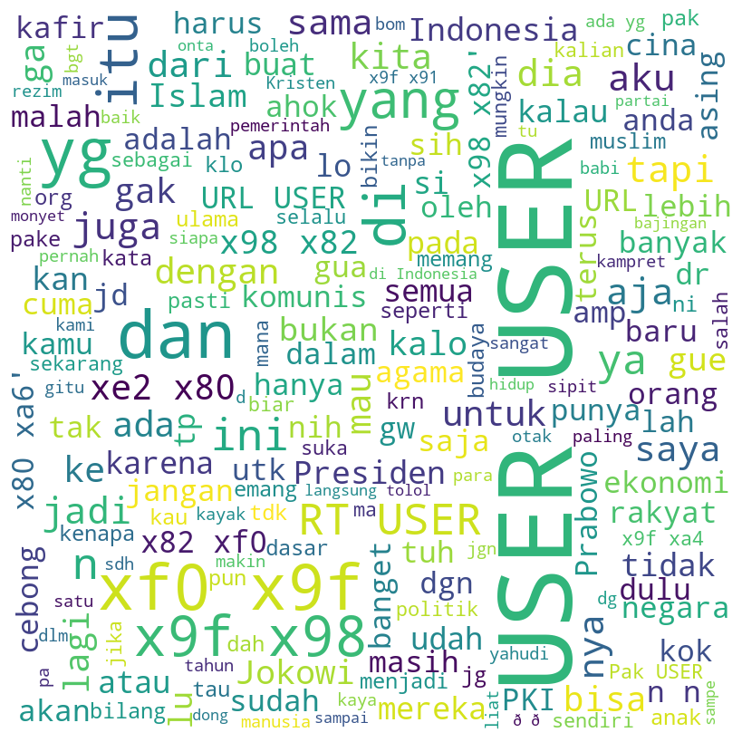
Mini-Application Development
Conditions in the initial tweet data created using wordcloud, it can be seen that there are still many abusive words, there are still tweets that use capital letters. Tweets still contain many unnecessary characters such as numbers and symbols.

Slide 12
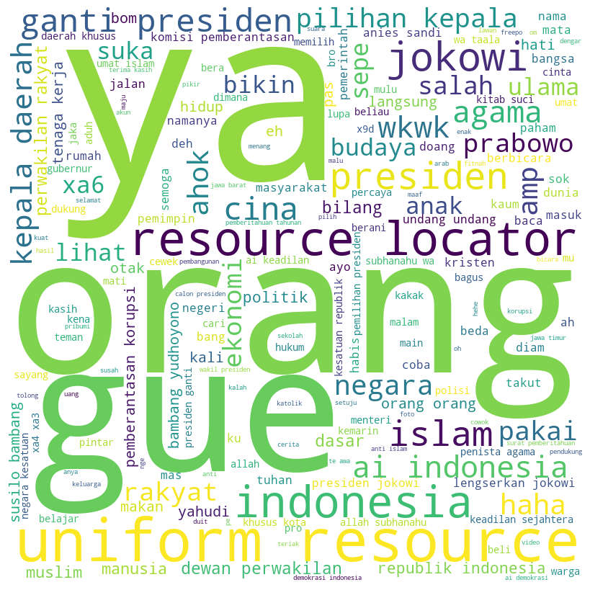
Mini-Application Development
After the data was inputted into the mini-app, it became cleaner, the abusive words disappeared, all letters were changed to lowercase, and the word "alay" was changed to a standard word.

Slide 13
Conclusion
Based on the results of tweet sentiment analysis with descriptive methods, Non-toxic tweets are more dominant, namely as many as 5,860 (44.5%) tweets, followed by Toxic tweets as many as 3,295 (25%) other tweets as 4,014 (30.5%) from a total of 13,169 tweets. And the mini-app has succeeded in eliminating abusive words and replacing "Alay" words with standard words.

Slide 14
Bibliography
A. P. J. Dwitama. Deteksi Ujaran Kebencian Pada Twitter Bahasa Indonesia. Menggunakan Machine Learning: Reviu Literatur. Jurnal SNATi. Volume 1. Nomor 1. 2021.
F. F. Mailo., L. Lazuardi. Analisis Sentimen Data Twitter Menggunakan Metode Text Mining Tentang Masalah Obesitas Indonesia. Journal Of Information System For Public Health, Vol. 4,No. 1, April 2019.
O. H. Rahman., G. Abdillah., A. Komarudin. Klasifikasi Ujaran Kebencian pada Media Sosial Twitter Menggunakan Support Vector Machine. Jurnal Rekayasa Sistem dan Teknologi Informasi. Vol. 5 No. 1 (2021) 17-23.
I. F. PUTRA., Indonesian Abusive and Hate Speech Twitter Text (2020) <https://www.kaggle .com/datasets/
ilhamfp31/indonesian-abusive-and-hate-speech-twitter-text/code>

Slide 15
THANK YOU

